Slide 1

SC1007 Data Structures and Algorithms
Week 8: Hash Table &
Graph Representation
Instructor: Luu Anh Tuan
Email: anhtuan.luu@ntu.edu.sg
Office: #N4-02b-66
School of Computer Science and Engineering

Slide 2
Overview
Hash Table
Graph Terminology
Graph Representation
Adjacency Matrix
Adjacency List

Slide 3
Hashing
A typical space and time trade-off in algorithm
To achieve search time in O(1), memory usage will be increased

Slide 4
What is hashing?
Direct-Address Table
Assume that the keys of elements K drawn from the universe of possible keys U
No two elements have the same key
Search time is O(1) but …
The array size is enormous
|U| >> |K|

Slide 5
What is hashing?
To reduce the key space to a reasonable size
Each key is mapped to a unique index (hash value/code/address)
Search time remains O(1) on the average
hash function: {all possible keys} → {0, 1, 2, …, h-1}
The array is called a hash table
Each entry in the hash table is called a hash slot
When multiple keys are mapped to the same hash value, a collision occurs
If there are $n$ records stored in a hash table with $h$ slots, its load factor is $α=\frac{n}{h}$

Slide 6
Hash Functions
Must map all possible value within the range of the hash table uniquely
Mapping should achieve an even distribution of the keys
Easy and fast to compute
Minimize collision
Modulo Arithmetic
Folding
Mid-square
Multiplicative Congruential Method
Etc.

Slide 7
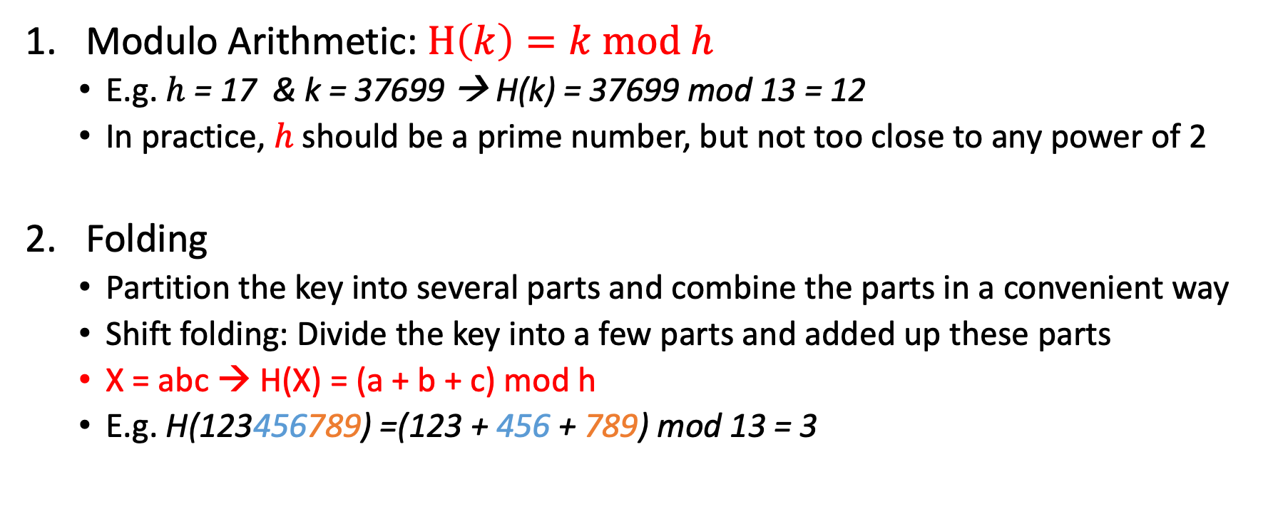
Hash Functions
Modulo Arithmetic: $H\left(k\right)=k mod h$
E.g. $h$ = 17 & k = 37699 → H(k) = 37699 mod 13 = 12
In practice, $h$ should be a prime number, but not too close to any power of 2
Folding
Partition the key into several parts and combine the parts in a convenient way
Shift folding: Divide the key into a few parts and added up these parts
X = abc → H(X) = (a + b + c) mod h
E.g. H(123456789) =(123 + 456 + 789) mod 13 = 3

Slide 8
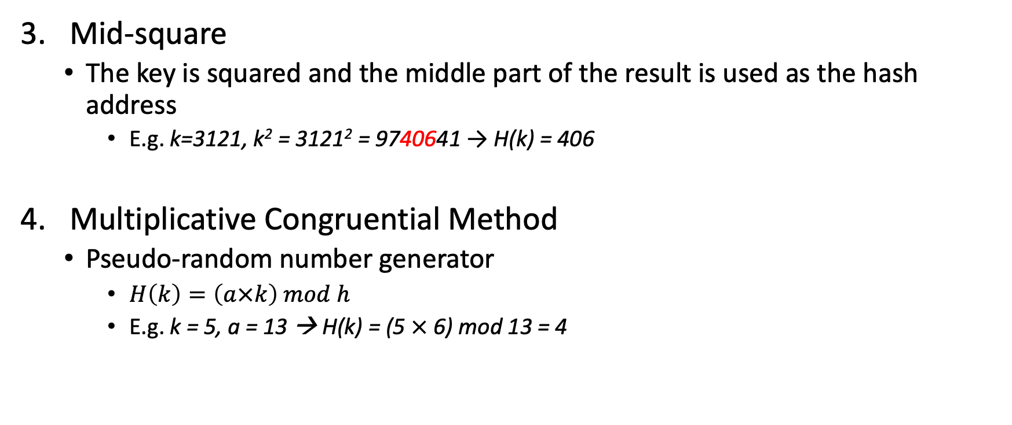
Hash Functions
Mid-square
The key is squared and the middle part of the result is used as the hash address
E.g. k=3121, k² = 3121² = 9740641 → H(k) = 406
Multiplicative Congruential Method
Pseudo-random number generator
$H\left(k\right)=\left(a×k\right) mod h$
E.g. k = 5, a = 13 → H(k) = (5 $×$ 6) mod 13 = 4

Slide 9
Collision Resolutions
Closed Addressing Hashing – a.k.a separate chaining
Open Addressing Hashing
Linear Probing
Quadratic Probing
Double Probing

Slide 10
Closed Addressing: Separate Chaining
Keys are not stored in the table itself
All the keys with the same hash address are store in a separate list
During searching, the searched element with hash address i is compared with elements in linked list H[i] sequentially
In closed address hashing, there will be $α$ number of elements in each linked list on average.
T
i
84
39
92
h(84) = h(39) = h(92) = i

Slide 11
Closed Addressing: Separate Chaining
Time complexity in the worst-case analysis:
When all elements are hashed to the same slot
A linked list contains all $n$ elements
Its unsuccessful search takes n key comparisons, $Θ(n)$
Its successful search, assuming the probability of searching for each item is $\frac{1}{n}$ $\frac{1}{n}\sum_{i=1}^{n}{i}=\frac{n+1}{2}=Θ(n)$
It is just like a sequential search

Slide 12
Closed Address Hashing: Separate Chaining
Time complexity in the average-case analysis:
All elements are equally likely hashed into $h$ slots.
Its unsuccessful search takes $\frac{n}{h}$ key comparisons, $Θ(α)$
Its successful search takes 1 more than the number of comparisons done when the sought after item was inserted into the hash table
Before the i^{th} item is inserted into the hash table, the average length of all lists is $\frac{i−1}{h}$
When the ith item is sought for, the no. of comparisons is ($1+\frac{i−1}{h}$)
The average number of key comparisons over $n$ items
If $α$ is constant ($n$ is proportional to $h)$, then $Θ(1)$
Searching takes constant time averagely
$$\frac{1}{n}\sum_{i=1}^{n}{\left(1+\frac{i−1}{h}\right)}=\frac{1}{n}(\sum_{i=1}^{n}{1}+\frac{1}{h}\sum_{i=1}^{n}{\left(i−1\right)})$$
$$= 1 +\frac{1}{nh}\left(\frac{n}{2}\left(n−1\right)\right)$$
$= 1 +\frac{n−1}{2h}=Θ(1+α$)

Slide 13
Open Addressing
Keys are stored in the table itself
$α$ cannot be greater than 1
When collision occurs, probe is required for the alternate slot
Ideally, the probing approach can visit every possible slot.
Linear Probing: probe the next slot
$H\left(k,i\right)=\left(k+i\right) mod h$ where $i∈[0,h−1]$
eg. $H\left(k,i\right)=\left(k+i\right) mod 7$
$k∈\{4, 13, 19, 11\}$
Primary clustering:
A long runs of occupied slots
Average search time is increased
0
11
1
(11+3)mod7
2
4
13
11
19
3
4mod7
11mod7
(11+1) mod7
19mod7
4
4
(11+2)mod7
13mod7
5
19
6
13

Slide 14
Open Addressing
Quadratic Probing
$H\left(k,i\right)=\left(k+c_{1}i+c_{2}i^{2}\right) mod h$ where $c_{1}$ and $c_{2}$ are constants, $c_{2}≠0$
May not all hash table slots be on the probe sequence (selection of $c_{1}$, $c_{2}$, $h$are important)
Any prime number h choice will only have at most h/2 distinct probes
For $h=2^{n}$, a good choice for the constants are $c_{1}=c_{2}=\frac{1}{2}$
eg. $H\left(k,i\right)=\left(k+\frac{1}{2}i+\frac{1}{2}i^{2}\right) mod$8
$k∈\{4, 13, 19, 11\}$
Secondary Clustering: if two keys have the same initial probe position,
their probe sequences will be the same. This will form a clustering.
Inserting k=3 in the previous example.
0
1
$(\frac{1}{2}i+\frac{1}{2}i^{2}$)mod 8
1
3
6
2
7
5
4
2
11mod8
13
19mod8
3
19
4
11
19
(11+1) mod8
4mod8
(11+3)mod8
4
4
13mod8
5
13
6
11
7

Slide 15
Open Addressing
Double Hashing: a random probing method
$H\left(k,i\right)=\left(k+iD(k)\right) mod h$ where $i∈[0,h−1]$ and $D(k)$ is another hash function
The hash table size $h$should be a prime number
eg. $H\left(k,i\right)=\left(k+iD(k)\right) mod 7$
$D\left(k\right)=\left(k\right) mod 3+1$
$k∈\{0, 4, 13, 19, 11\}$
0
0
D(11) = 11 mod 3 + 1
1
(11+3)mod7
0 mod7
2
19
(11+2*3) mod7
3
11
4
13
0
11
11mod7
19mod7
4
4mod7
4
13mod7
5
19
6
13

Slide 16
Time Complexity
Linear Probing
Successful Search: $\frac{1}{2}(1+\frac{1}{1−α})$
Unsuccessful Search: $\frac{1}{2}(1+{\left(\frac{1}{1−α}\right)}^{2})$
Double Hashing
Successful Search: $\frac{1}{α}\ln{\frac{1}{1−α}}$
Unsuccessful Search: $\frac{1}{1−α}$
*Proof can be found in The Art of Computer Programming by Knuth Donald (1973)

Slide 17
Delete A Key Under Open Addressing
Leave the deleted key in the table
Make a marker indicating that it is deleted
Overwrite it when a new key is inserted to the slot
May need to do a “garbage collection” when a large number of deletions are done
To improve the search time

Slide 18
Rehashing: Expanding the Hash Table
As $α$ increases, the time complexity also increases
Solution:
Increase the size of hash table (doubled)
Rehash all keys into new larger hash table

Slide 19
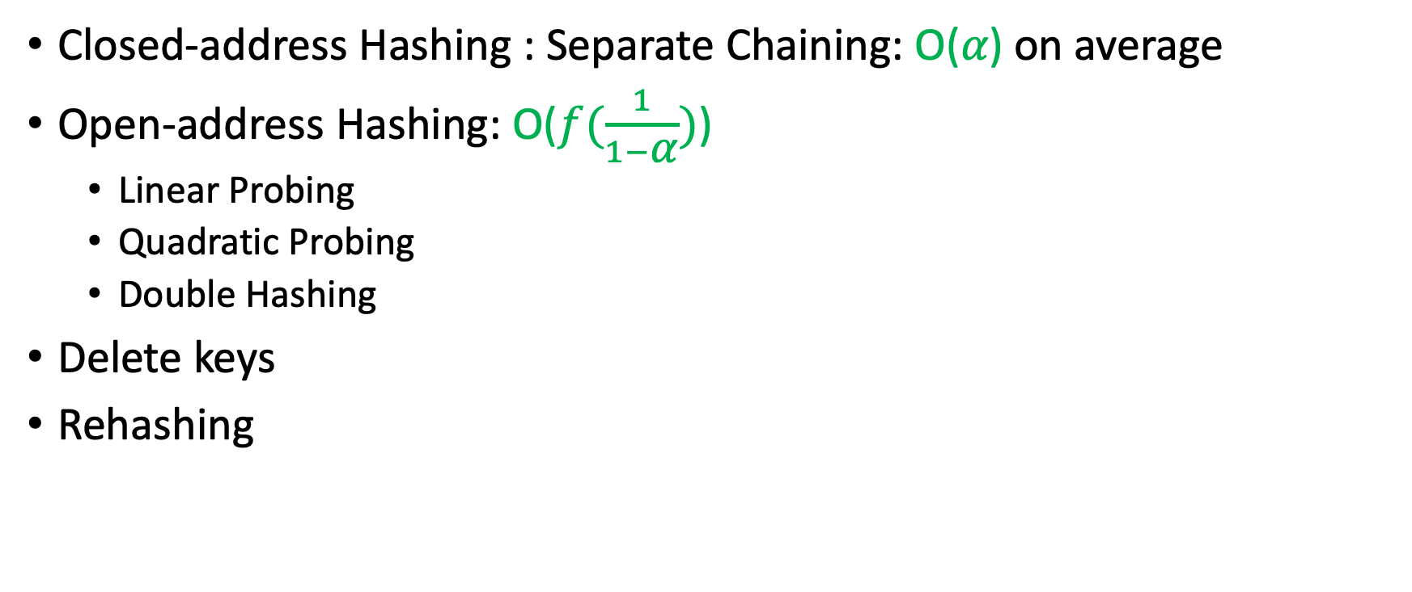
Hash Table: Summary
Closed-address Hashing : Separate Chaining: O(𝛼) on average
Open-address Hashing: O($f(\frac{1}{1−\text{α}})$)
Linear Probing
Quadratic Probing
Double Hashing
Delete keys
Rehashing

Slide 20
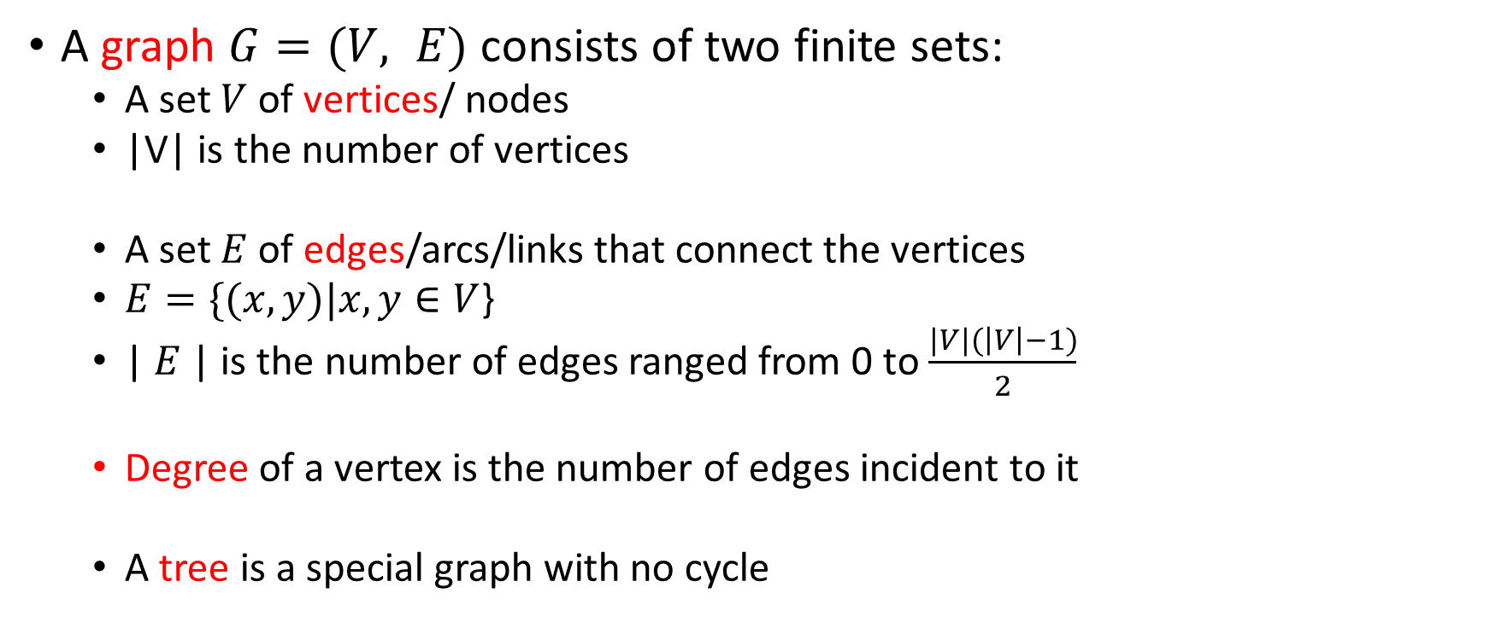
Graph Terminology
A graph $G=(V, E)$ consists of two finite sets:
A set $V$of vertices/ nodes
|V| is the number of vertices
A set $E$ of edges/arcs/links that connect the vertices
$E=\{(x,y)|x,y∈V$}
| $E$| is the number of edges ranged from 0 to $\frac{|V|(\left|V\right|−1)}{2}$
Degree of a vertex is the number of edges incident to it
A tree is a special graph with no cycle

Slide 21
Graph Terminology
5
A
B
A
7
B
8
3
2
C
D
C
D
1
Undirected Graph
Weighted Graph
A
B
A
B
C
D
C
D
Directed Graph
Complete Graph

Slide 22
Graph Terminology
If e = (x, y) is an edge in an undirected graph, then e is incident with x and y; x is adjacent to y and vice versa.
If E is unordered, then G is undirected; otherwise, G is a directed graph.
If e = (x, y) is an edge in a directed graph, then y can be reached from x through one edge, so target y is adjacent to source x (but it doesn’t mean x is adjacent to y).

Slide 23
Graph Terminology
A path is a sequence of distinct vertices, each adjacent to the predecessor (except for the first vertex). |V| = |E|+1
ABDC
A cycle is a path containing at least three vertices such that the last vertex on the path is the same as the first. |V| = |E|
ABDCA
A
7
B
8
2
C
D
1

Slide 24
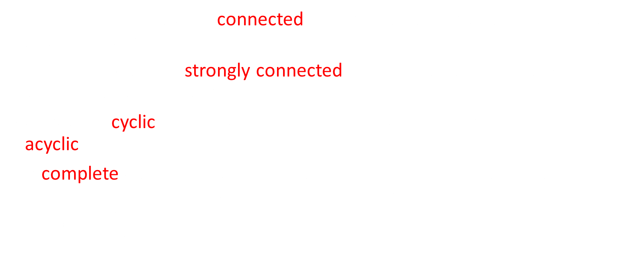
Graph Terminology
An undirected graph is connected if there is a path from any vertex to any other vertex.
A directed graph is strongly connected if there is a path from any vertex to any other vertex.
A graph is cyclic if it contains one or more cycles; otherwise it is acyclic.
A complete graph on n vertices is a simple undirected graph that contains exactly one edge between each pair of distinct vertices.
$|E|=\frac{|V|(\left|V\right|−1)}{2}$

Slide 25

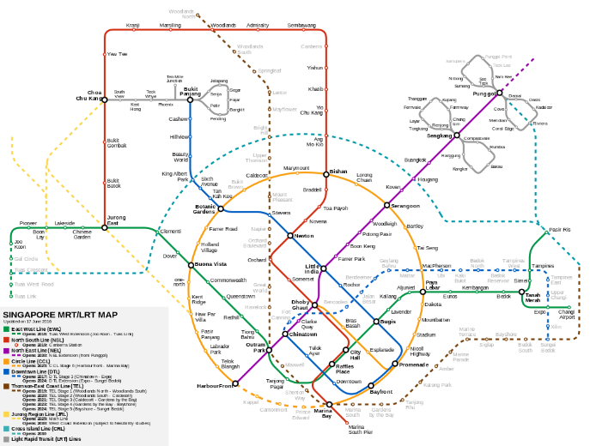
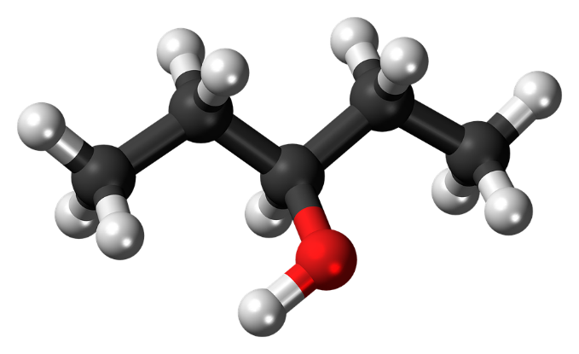
Graph Applications
Electrical circuits
V = {electrical devices}
E = {linkage between devices}
Maps
V = {stations}
E = {underground route}
Organic Chemistry
V = {atoms}
E = {bonds between atoms}
Computer Networks
V = {computers}
E = {connections between computers}
Aforl. (2014). A map of Singapore’s Mass Rapid Transit (MRT) and Light Rail Transit (LRT) systems [Image]. Retrieved from https://commons.wikimedia.org/wiki/File:Singapore_MRT_and_LRT_System_Map.svg
File: Electric circuit [Image]. (2013). Retrieved from https://pixabay.com/en/board-chip-circuit-electric-158973
Chemistry-atoms [Image]. (2015). Retrieved from https://pixabay.com/en/pentanol-molecule-chemistry-atoms-867210/

Slide 26
Graph Representation
Adjacency Matrix
Adjacency List
4
12
11
1
8
3
2
5
6
7
9
10

Slide 27

Adjacency Matrix
Use a matrix (2-D array) with size $|V|×|V|$
$(u,v)∈E$ implies AdjM[u][v] = 1; Otherwise AdjM[u][v] = 0.
If a graph is undirected, then AdjM is symmetric
AdjM[u][v] = AdjM[v][u]
If a graph is directed, then AdjM[u][v] = 1 iff $(u,v)∈E$ but it does not imply $(v,u)∈E$ and AdjM[v][u] = 1.
typedef struct _graph{
int vSize;
int eSize;
int **AdjM;
}Graph;

Slide 28
Adjacency Matrix
typedef struct _graph{
int vSize;
int eSize;
int **AdjM;
}Graph;
access time for AdjM[u][v] is constant
when graph is sparsely connected, most of the entries in AdjM are zeros
12
 | 1 | 2 | 3 | 4 | 5 | 6 | 7 | 8 | 9 | 10 | 11 | 12
1 | 0 | 1 | 1 | 1 | 0 | 0 | 0 | 0 | 0 | 0 | 1 | 0
2 | 1 | 0 | 0 | 0 | 1 | 1 | 0 | 0 | 0 | 0 | 1 | 0
3 | 1 | 0 | 0 | 0 | 0 | 0 | 1 | 1 | 0 | 0 | 0 | 0
4 | 1 | 0 | 0 | 0 | 0 | 0 | 0 | 0 | 0 | 0 | 0 | 0
5 | 0 | 1 | 0 | 0 | 0 | 0 | 0 | 0 | 0 | 0 | 0 | 0
6 | 0 | 1 | 0 | 0 | 0 | 0 | 0 | 0 | 1 | 1 | 0 | 0
7 | 0 | 0 | 1 | 0 | 0 | 0 | 0 | 0 | 0 | 0 | 0 | 0
8 | 0 | 0 | 1 | 0 | 0 | 0 | 0 | 0 | 0 | 0 | 0 | 1
9 | 0 | 0 | 0 | 0 | 0 | 1 | 0 | 0 | 0 | 0 | 0 | 0
10 | 0 | 0 | 0 | 0 | 0 | 1 | 0 | 0 | 0 | 0 | 0 | 0
11 | 1 | 1 | 0 | 0 | 0 | 0 | 0 | 0 | 0 | 0 | 0 | 0
12 | 0 | 0 | 0 | 0 | 0 | 0 | 0 | 1 | 0 | 0 | 0 | 0
11
4
1
8
3
2
5
6
7
9
10

Slide 29
Adjacency List
struct _listnode
{
int id; //or weight
struct _listnode *next;
};
typedef struct _listnode ListNode;
typedef struct _graph{
int vSize;
int eSize;
ListNode **AdjL;
}Graph;
Use an array to represent the vertices
For each vertex, use a linked list to represent the connections to other vertices
Access time for AdjM[u][v] is linear
Space complexity is lower, O(|V|+|E|)

Slide 30
Adjacency List
Array size is |V|.
Total number of nodes in link lists is 2|E|
1
2
3
4
5
6
7
8
9
10
11
12
→ 2 → 3 → 4 → 11
4
12
→ 11 → 1 → 5 → 6
11
→ 1 → 8 → 7
→ 1
1
8
→ 2
3
→ 10 → 9 → 2
→ 3
2
→ 12 → 3
5
6
7
→ 6
→ 6
9
10
→ 2 → 1
→ 8

Slide 31

Represent Weighted Graphs
In the array of adjacency lists, the weight can be stored as a data field in each list node
In the adjacency matrices, the weight can be stored
The element at the u-th row and the v-th column can be defined as:
$$AdjM\left[u\right][v] =\left\{\begin{aligned}W\left(u,v\right) if (u,v)∈E \\ c otherwise\end{aligned}\right.$$
Constant $c$ can be defined as 0 (weight as capacity) or some very large number ∞ (weight as cost)

Slide 32
Represent Weighted Graphs
25
1
2
10
5
14
6
3
4
18
 | 1 | 2 | 3 | 4
1 | 0 | 25 | 0 | 0
2 | 0 | 0 | 10 | 14
3 | 5 | 0 | 0 | 0
4 | 0 | 6 | 18 | 0
1
2
3
4
→ (2, 25)
→ (3, 10) → (4, 14)
→ (1, 5)
→ (2, 6) → (3, 18)

Slide 33
Summary
Concepts and terminologies of graph, such as
A graph consists of a set of vertices and a set of edges
Directed vs. undirected graphs
The definitions of path and cycle, etc.
Two data structures used to represent graphs:
Adjacency matrix
Array of adjacency lists
Their advantages and disadvantages for different applications

Slide 34
SC1007 Data Structures and Algorithms
Week 9: Graph Traverse
BFS & DFS
Instructor: Luu Anh Tuan
Email: anhtuan.luu@ntu.edu.sg
Office: #N4-02b-66
School of Computer Science and Engineering

Slide 35
Overview
Traversal of Graph
Breadth-first Search
Depth-first Search

Slide 36
Traversal of Graphs
To traverse a graph means to visit the vertices of the graph in some systematic order.
The traversal problem: check all nodes once and only once
To traverse a graph, we can apply:
Breadth-first Search
Depth-first Search

Slide 37
Breadth First Search (BFS)
Work similar to level-order traversal of the trees
BFS systematically explores the edges directly connected to a vertex before visiting vertices further away.
12
4
12
11
4
11
1
1
8
8
3
3
2
2
7
6
7
5
6
5
9
10
9
10

Slide 38

Breadth First Search (BFS)
typedef struct _linkedlist{
ListNode *head;
int size;
} LinkedList;
typedef ListNode QueueNode;
typedef struct _queue{
int size;
ListNode *head;
ListNode *tail;
} Queue;
A queue is used to monitor which vertices to visit the next
Action taken during visiting $v_{i}$ depends on specific applications
A
D
A
D
B
B
G
G
F
C
E
F
C
E

Slide 39
Breadth First Search (BFS)
A
D
A
D
B
B
G
G
F
C
E
F
C
E
A
D
A
D
B
B
G
G
F
C
E
F
C
E

Slide 40
BFS Algorithm
12
4
12
4
11
11
1
1
8
8
3
3
2
2
7
6
7
5
6
5
9
10
9
10

Slide 41
Breadth First Search (BFS)
If a vertex has several unmarked neighbours, it would be equally correct to visit them in any order.
If the shortest path from s to any vertex v is defined as the path with the minimum number of edges, then BFS finds the shortest paths from s to all vertices reachable from s.
The tree built by BFS is called the breadth first spanning tree (when graph G is connected).

Slide 42
Applications of BFS
Finding all connected components in a graph
Finding all vertices within one connected component
Finding the shortest path between two vertices

Slide 43
Time Complexity of BFS
Each edge is processed once in the while loop for a total cost of Θ(|E|)
Each vertex is queued and dequeued once for a total cost of Θ(|V|)
The worst-case time complexity for BFS is
Θ(|V| + |E|) if graph is represented by adjacency lists
Θ(|V|²) if graph is represented by an adjacency matrix
each vertex takes Θ(|V|) to scan for its neighbours

Slide 44
Depth First Search (DFS)
Work similar to preorder traversal of the trees
DFS systematically explores along a path from vertex v as deeply into the graph as possible before backing up.
12
4
12
11
4
11
1
1
8
8
3
3
2
2
7
6
7
5
6
5
9
10
9
10

Slide 45
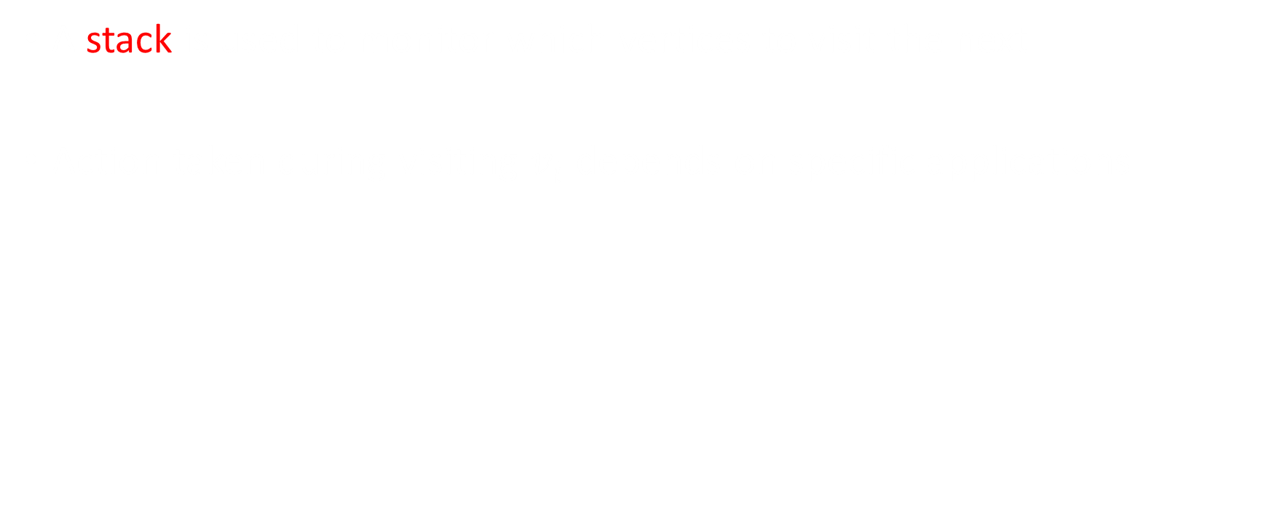
Depth First Search (DFS)
struct _listnode
{
int item;
struct _listnode *next;
} ListNode;
typedef struct _linkedlist{
ListNode *head;
int size;
} LinkedList;
typedef ListNode StackNode;
typedef LinkedList Stack;
A stack is used to monitor which vertices to visit the next
Action taken during visiting $v_{i}$ depends on specific applications
dfs(G, ‘A’)
dfs(G, ‘B’)
dfs(G, ‘C’)
A
D
A
D
A
D
B
H
B
H
B
H
F
C
E
F
C
E
F
E
C

Slide 46
Depth First Search (DFS)
Back to dfs(G, ‘B’) then dfs(G, ‘D’)
dfs(G, ‘D’)
Back to dfs(G, ‘B’)
A
D
A
D
A
D
B
H
B
H
B
H
F
C
E
F
C
E
F
C
E
Back to dfs(G, ‘A’) then dfs(G, ‘F’)
Back to dfs(G, ‘A’)
A
D
A
D
B
H
B
H
F
C
E
F
C
E
This directed graph is not strongly connected

Slide 47
DFS Algorithm
dfs(G, ‘A’)
A
D
B
H
F
C
E

Slide 48
Depth First Search (DFS)
If a vertex has several neighbours it would be equally correct to go through them in any order.
If the graph is strongly connected, the tree T, constructed by the DFS algorithm is a spanning tree, i.e., a set of |V|-1 edges that connect all vertices of the graph. T is called the depth first search tree.
Spanning tree
A
D
A
D
B
B
DFS
F
C
F
C

Slide 49
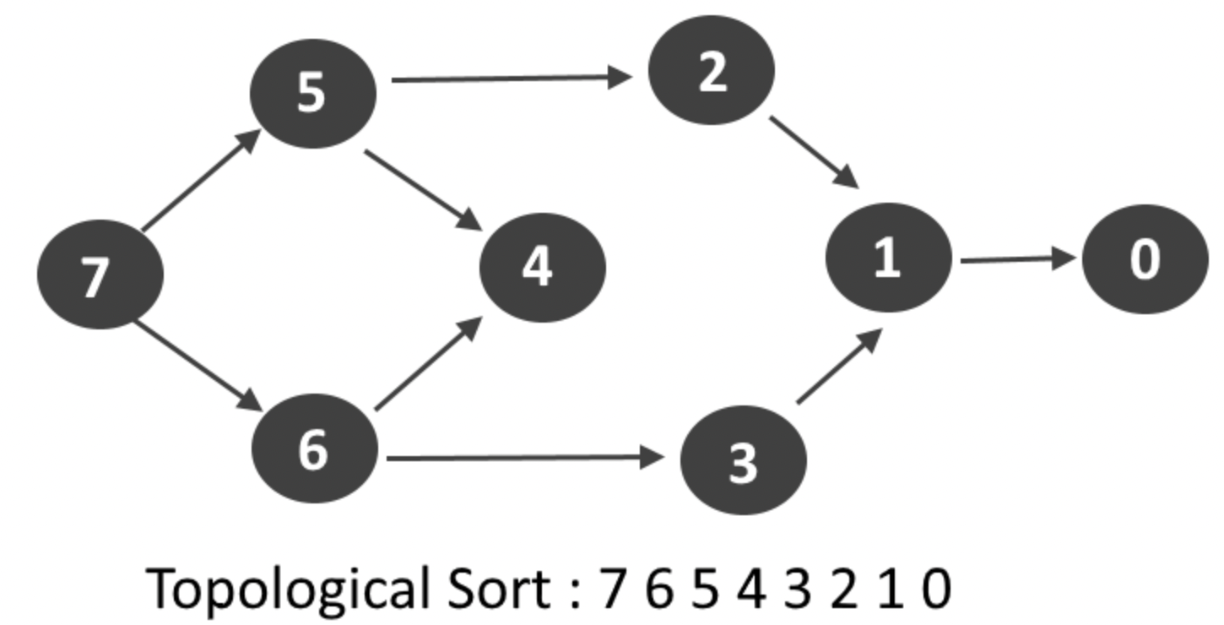
Applications of DFS
Topological Sorting
Finding connected components
Finding articulation points (cut vertices) of the graph
Finding strongly connected components
Solving puzzles

Slide 50
Time Complexity of DFS
The DFS algorithm visits each node exactly once; every edge is traversed once in forward direction (exploring) and once in backward direction (backtracking).
Using adjacency-lists, time complexity of DFS is Θ(|V| + |E|).

Slide 51
Summary
Two elementary algorithms for graph traversal
Breadth-first search (BFS): Use queue – Finding shortest paths
Depth-first search (DFS): Use stack – solving some puzzles
Time complexity of BFS or DFS:
Using adjacency lists: Θ (|V| + |E|)
Using adjacency matrix: Θ (|V|²)

Slide 52
SC1007 Data Structures and Algorithms
Week 10: Backtracking Algorithm
Instructor: Luu Anh Tuan
Email: anhtuan.luu@ntu.edu.sg
Office: #N4-02b-66
School of Computer Science and Engineering

Slide 53
Backtracking
Suppose you make a series of decisions, among various choices, where:
You don’t have enough information to know what to choose
Each decision leads to a new set of choices
Some sequence of choices (possibly more than one) may be a solution to your problem
Backtracking is a methodical way of trying out various sequences of decisions, until you find one that “works”

Slide 54
Backtracking (animation)
dead end
?
dead end
dead end
?
start
?
?
dead end
dead end
?
success!

Slide 55
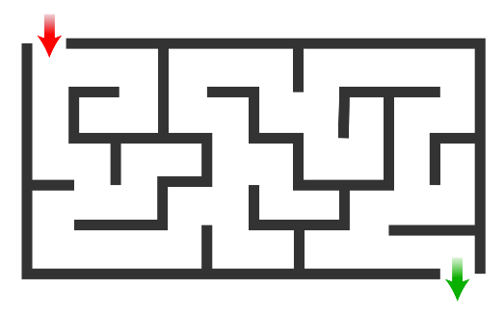
Solving a maze
Given a maze, find a path from start to finish
At each intersection, you have to decide:
Go straight
Go left
Go right
You don’t have enough information to choose correctly
Each choice leads to another set of choices
One or more sequences of choices may (or may not) lead to a solution
Many types of maze problem can be solved with backtracking

Slide 56
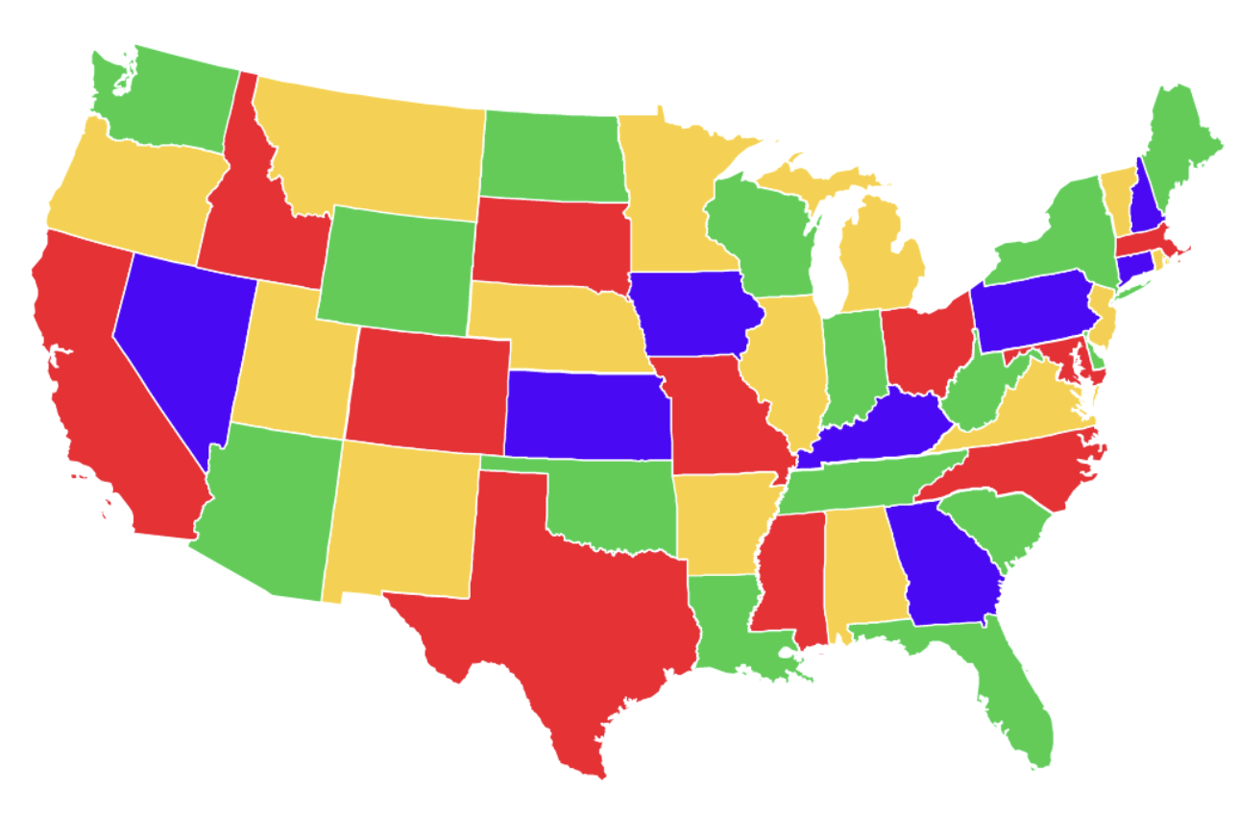
Coloring a map
You wish to color a map with not more than n colors
Adjacent regions must be in different colors
You don’t have enough information to choose colors
Each choice leads to another set of choices
One or more sequences of choices may (or may not) lead to a solution
Many coloring problems can be solved with backtracking

Slide 57
Terminology
A tree is composed of nodes
There are three kinds of nodes:
The (one) root node
Backtracking can be thought of as searching a tree for a particular “goal” leaf node
Internal nodes
Leaf nodes

Slide 58
The backtracking algorithm
Backtracking is really quite simple--we “explore” each node, as follows:
To “explore” node N:
If N is a goal node, return “success”
Else if N is a leaf node, return “failure”
For each child C of N:
Explore C
If C was successful, return “success”
Return “failure”

Slide 59
Backtracking Algorithm
How to backtrack?
Recursive function
Backtracking(N)
If N is a goal node, return “success”
Else if N is a leaf node, return “failure”
For each child C of N,
If Backtracking(C) == “success”
Return “success”
Return “failure”

Slide 60

Coloring problem
Input format:
2D adjacency matrix representation graph[V][V]
Number of colors m
Output format:
array color[V] that should have numbers from 1 to m
Naïve solution: check all possible combinations
m^{|V|} combinations
If m= 4 and |V| = 64 → billion years to run

Slide 61
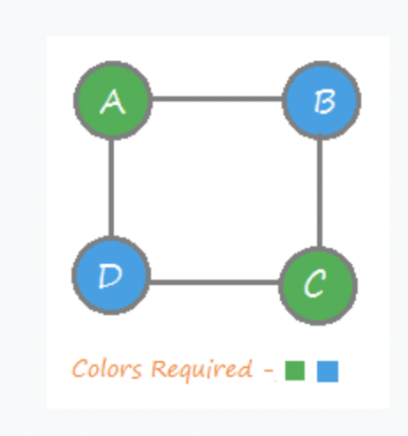
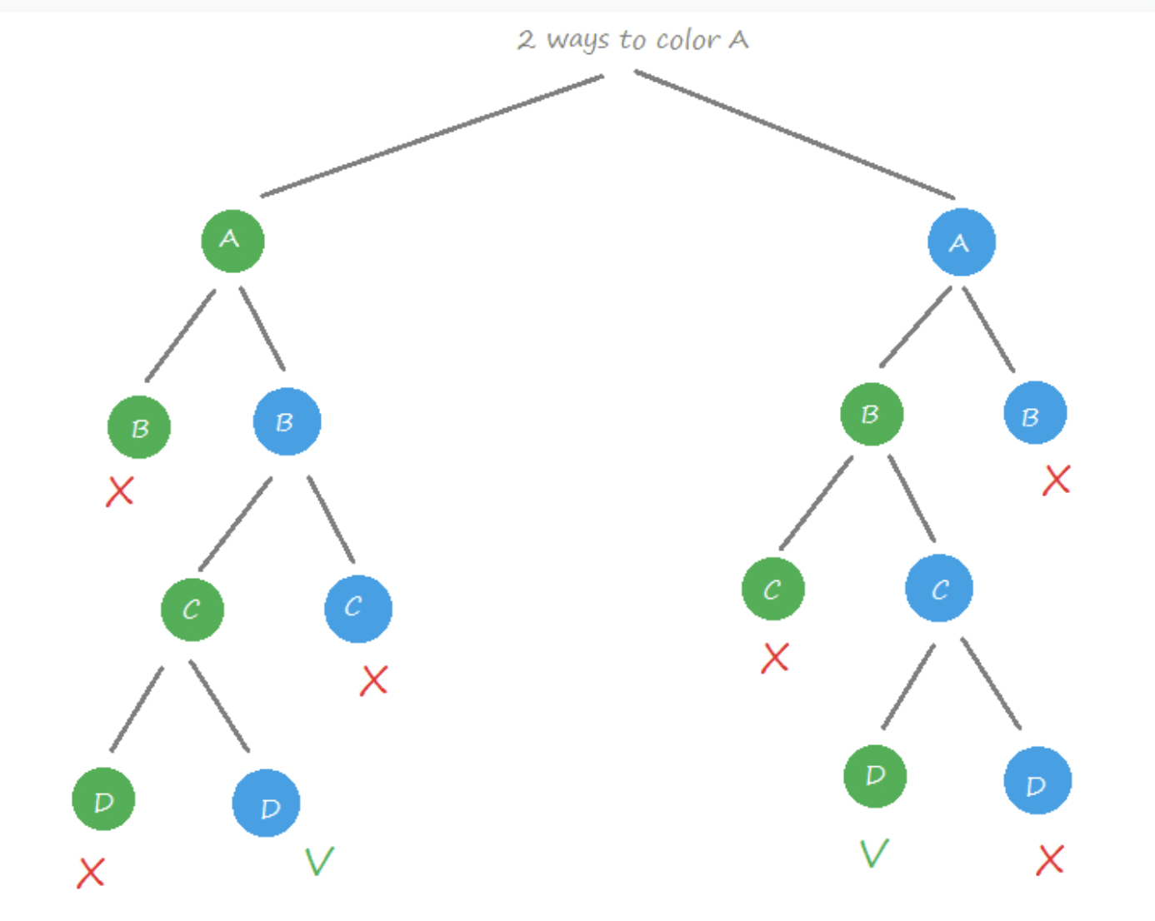
Backtracking

Slide 62
Coloring problem: Backtracking
Create a recursive function that takes current index
If the current index is equal to the number of vertices
Print the result.
Assign each color to a vertex (1 to m).
For every assigned color, check if the configuration is safe, recursively call the function with next index
If any recursive function returns True
break the loop and return True.
If no recursive function returns True then return False.

Slide 63
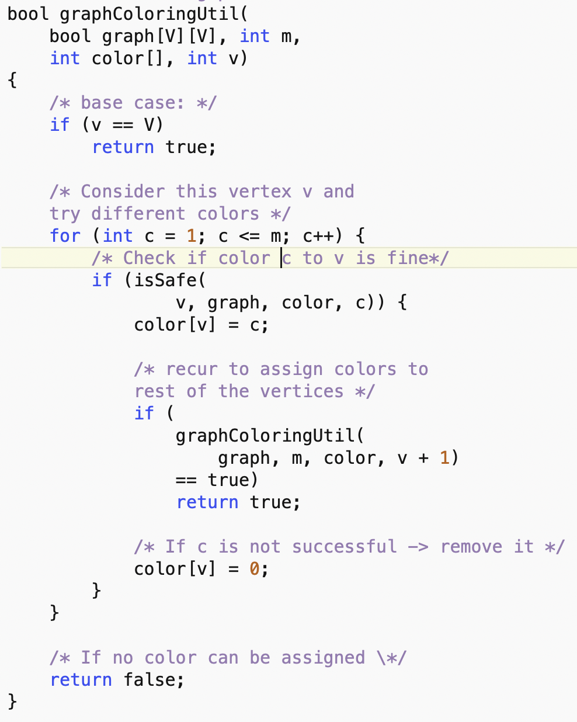
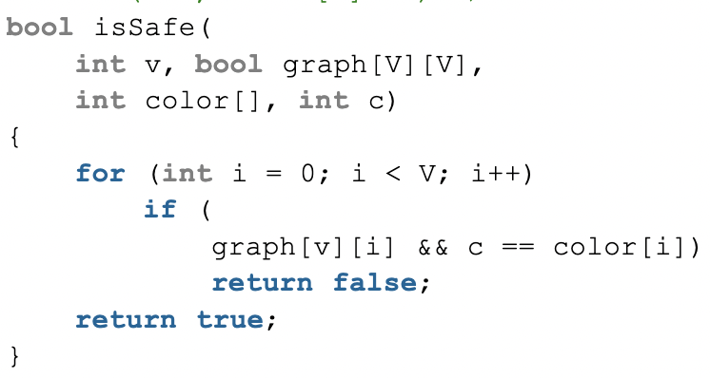

Slide 64

The Eight Queens Problem
A chessboard has 8 rows and 8 columns
A queen can move within its row or its column or along its diagonal
Place 8 queens on the board
No queen can attack any other queen in a move
Exhausting search will take $\left({64 \atop 8}\right)=4.43$ billion ways
Each row can contain exactly one queen: $8!=40$,320
Better algorithm?

Slide 65
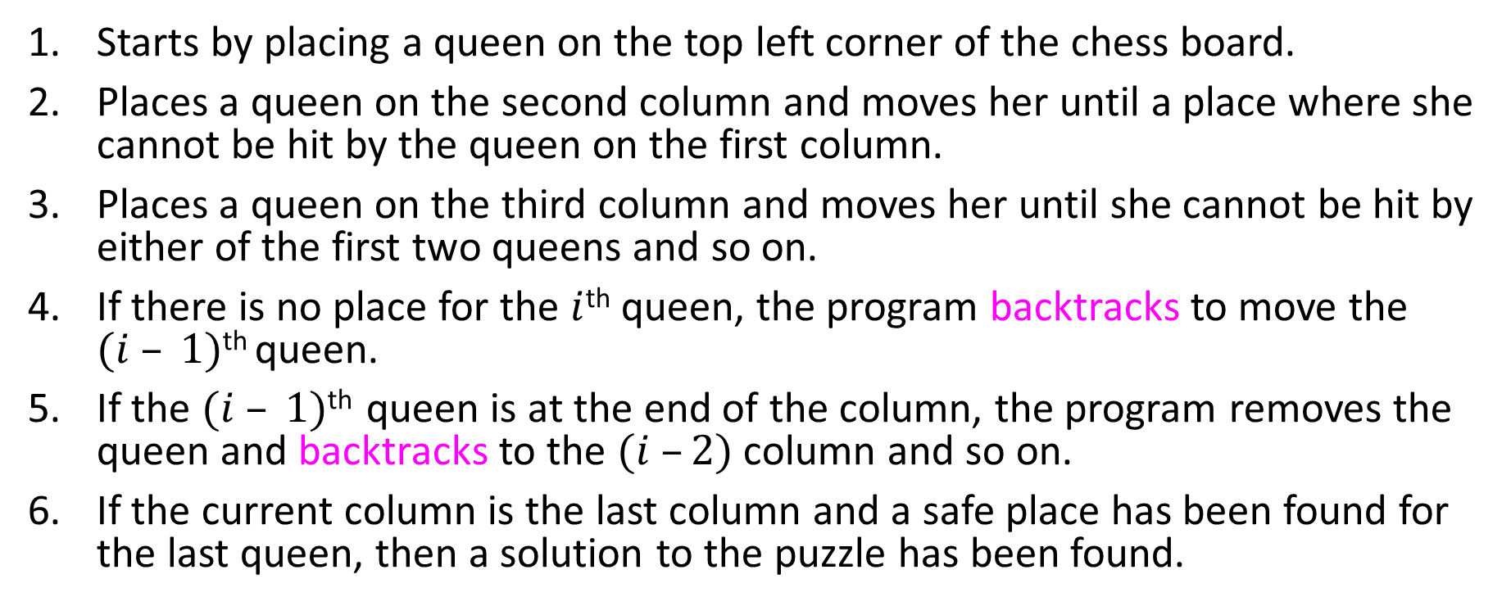
Backtracking Algorithm
Starts by placing a queen on the top left corner of the chess board.
Places a queen on the second column and moves her until a place where she cannot be hit by the queen on the first column.
Places a queen on the third column and moves her until she cannot be hit by either of the first two queens and so on.
If there is no place for the $i$^{th} queen, the program backtracks to move the $(i – 1)$^{th} queen.
If the $(i – 1)$^{th} queen is at the end of the column, the program removes the queen and backtracks to the $(i –2)$ column and so on.
If the current column is the last column and a safe place has been found for the last queen, then a solution to the puzzle has been found.

Slide 66
Backtracking Algorithm
If the current column is the first column and its queen is being moved off the board then all possible configurations have been examined, all solutions have been found, and the algorithm terminates.
This puzzle has 92 solutions.

Slide 67

N-Queens Problem
n | Possible Solutions
4 | 2
5 | 10
6 | 4
7 | 40
8 | 92
10 | 724
12 | 14,200
15 | 2,279,184
20 | 39,029,188,884

Slide 68
The Eight Queens Problem’s Algorithm

Slide 69
SC1007 Data Structures and Algorithms
Week 11: Dynamic Programming
Instructor: Luu Anh Tuan
Email: anhtuan.luu@ntu.edu.sg
Office: #N4-02b-66
School of Computer Science and Engineering

Slide 70
Fibonacci sequence
Let’s consider the calculation of Fibonacci numbers:
F(n) = F(n-1) + F(n-2)
with seed values F(0) = 0, F(1) = 1
The sequence look like:
0, 1, 1, 2, 3, 5, 8, 13, 21, 34, 55, 89, 144, …

Slide 71
Fibonacci sequence: recursive algorithm
Fib(n)
{
if (n == 0)
return 0;
if (n == 1)
return 1;
return Fib(n-1) + Fib(n-2);
}
It has a serious issue!

Slide 72
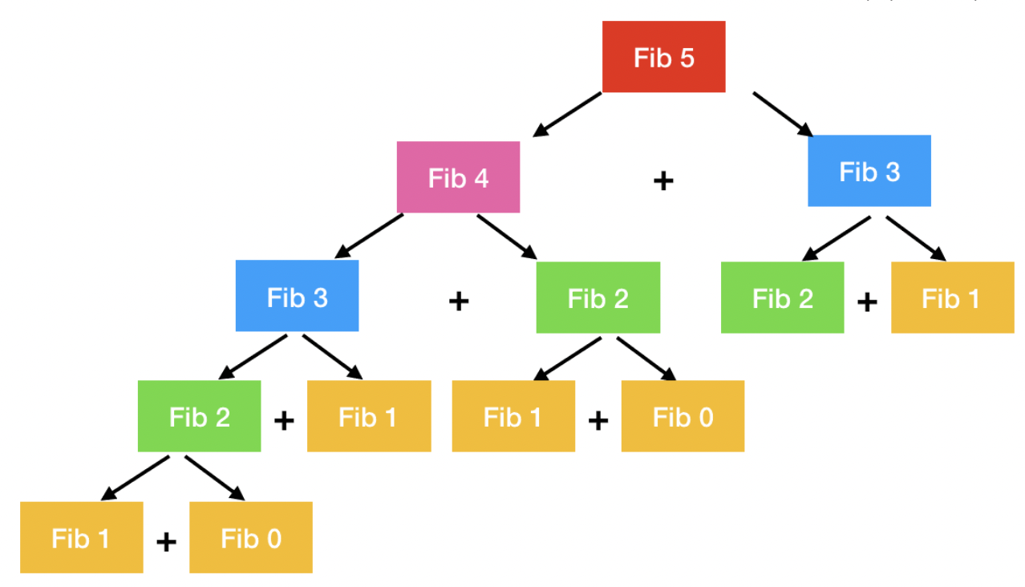
Recursion tree
What’s the problem?
Many subproblems are overlapping: a lot of recomputation
Complexity: O(2^{n})

Slide 73
What is Dynamic Programming (DP)?
Dynamic Programming = Recursion + Memoization
Recursion: problem can be solved recursively
Memoization: Store optimal solutions to sub-problems in table (or memory or cache)

Slide 74
What is Dynamic Programming (DP)?
It is similar to divide-and-conquer strategy
Breaking the big problem into sub-problems
Solve the sub-problems recursively
Combining the solutions to the sub-problems
What is the difference between them?
DP can be applied when the sub-problems are not independent
Every sub-problem is solved once and is saved in a table
The problem usually can have multiple optimal solutions
DP may just return one of them
If the sub-problems are independent, DP is not useful!

Slide 75
Dynamic Programming Approaches
Top-down approach
Recursively using the solution to its sub-problems
Memoize the solutions to the sub-problems and reuse them later
Bottom-up approach
Figure out the order of calculation
Solve the sub-problems to build up solutions to larger problem

Slide 76
Fibonacci: Top-down approach
Store an array M
Fib(n)
{
if (n == 0)
M[0] = 0; return 0;
if (n == 1)
M[1] = 1; return 1;
if (M[n-1] == -1) //F(n-1) was not calculated
M[n-1] = Fib(n-1) //calculate F(n-1) and store in M
if (M[n-2] == -1) //F(n-2) was not calculated
M[n-2] = Fib(n-2) //calculate F(n-2) and store in M
M[n] = M[n-1] + M[n-2]
return M[n];
}
 | 0 | 1 | 2 | 3 | 4 | 5 | 6
 | -1 | -1 | -1 | -1 | -1 | -1 | -1
Complexity: O(n)

Slide 77
Fibonacci: Bottom-up approach
Store an array M
Fib(n)
{
M[0] = 0;
M[1] = 1;
int i = 0;
for (i = 2; i<=n; i++)
M[i] = M[i-1] + M[i-2];
return M[n];
}
 | 0 | 1 | 2 | 3 | 4 | 5 | 6
 | -1 | -1 | -1 | -1 | -1 | -1 | -1
Complexity: O(n)

Slide 78
Other examples of DP
String algorithms like longest common subsequence, longest increasing subsequence, longest common substring etc.
Graph algorithms like Bellman-Ford algorithm, Floyd’s algorithm
Chain matrix multiplication
Rod Cutting
0/1 Knapsack
Travelling salesman problem
Subset Sum

Slide 79
Rod Cutting Problem
Given a rod of a certain length and price of rod of different lengths, determine the maximum revenue obtainable by cutting up the rod at different lengths based on the prices.
X cm
Length cm | 1 | 2 | 3 | 4 | 5 | 6 | 7 | 8 | 9
Price $ | 1 | 5 | 8 | 9 | 10 | 17 | 17 | 20 | 24

Slide 80
Rod Cutting Problem
Length cm | 1 | 2 | 3 | 4 | 5 | 6 | 7 | 8 | 9
Price $ | 1 | 5 | 8 | 9 | 10 | 17 | 17 | 20 | 24
If a rod of length 4,
Length of each piece | Total Revenue
4 | 9
1 + 3 | 1+8 = 9
1 + 1 + 2 | 1+1+5 =7
1 + 1 + 1 + 1 | 1+1+1+1=4
2 + 2 | 5+5 =10
From all possible solutions, the maximum revenue is 10 by cutting the rod into two pieces of length 2 each.

Slide 81
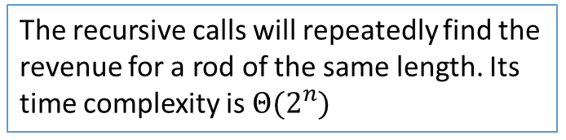
Naïve Top-down Recursive Approach
4
3
4
1
2
2
3
1
3
0
1
2
2
2
1
1
1
0
0
2
Cut-Rod (p,n)
begin
if n==0
return 0
q ← - ∞
for i = 1 to n do
q ← max (q, p[i] + Cut-Rod(p, n-i))
return q
end
1
1
0
The recursive calls will repeatedly find the revenue for a rod of the same length. Its time complexity is $Θ(2^{n})$
Notes:
In every recursive call, cut the rod into two pieces of length i and n-i. The second piece will be further cut into two piece via another recursive call to find its max revenue.

Slide 82
Top-down Memoized Approach
The result of each sub-problem is stored and reused
Cut-Rod (p,n)
begin
r[1,…,n] ← {0}
return Mem-Cut-Rod-Aux(p,n,r)
end
Mem-Cut-Rod-Aux (p,n,r)
begin
if n==0
return 0
if(r[n]>0)
return r[n]
else
q ← - ∞
for i = 1 to n do
q ← max (q, p[i] + Mem-Cut-Rod-Aux(p, n-i, r))
r[n] ← q
return q
end

Slide 83
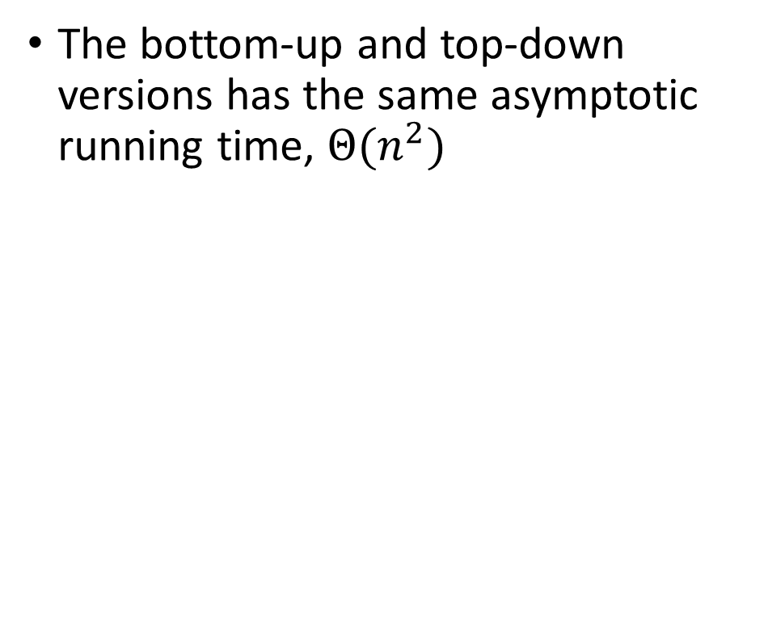
Bottom-up DP Approach
DP-Cut-Rod (p,n)
begin
r[1, …, n] ← {0}
for j = 1 to n do
for i = 1 to j do
r[j] ← max (r[j], p[i] + r[j-i])
return r[n]
end
The bottom-up and top-down versions has the same asymptotic running time, $Θ(n^{2})$
Length cm | 1 | 2 | 3 | 4 | 5 | 6 | 7 | 8 | 9
Price $ | 1 | 5 | 8 | 9 | 10 | 17 | 17 | 20 | 24
Max Rev $ | 1 | 5 | 8 | 10 | 13 | 17 | 18 | 22 | 25

Slide 84

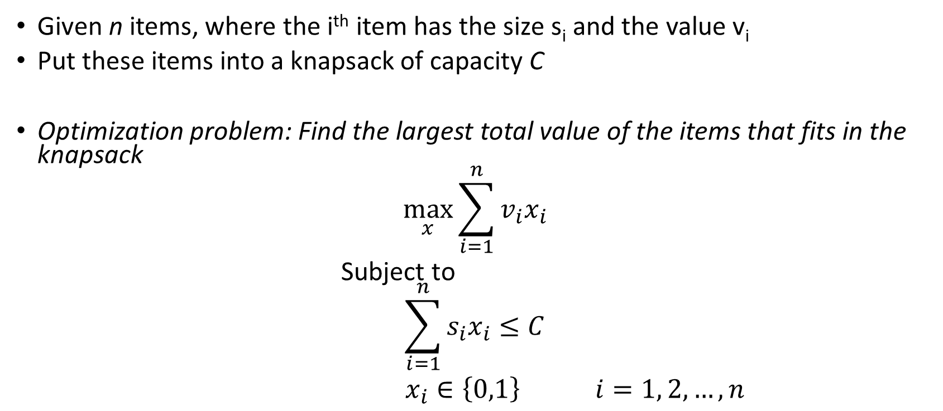
0/1 Knapsack
Given n items, where the i^{th} item has the size s_{i} and the value v_{i}
Put these items into a knapsack of capacity C
Optimization problem: Find the largest total value of the items that fits in the knapsack
$$\max_{x}{\sum_{i=1}^{n}{v_{i}x_{i}}}$$
Subject to
$$\sum_{i=1}^{n}{s_{i}x_{i}}≤C$$
$x_{i}∈\left\{0,1\right\}$ $i=1, 2, …,n$

Slide 85
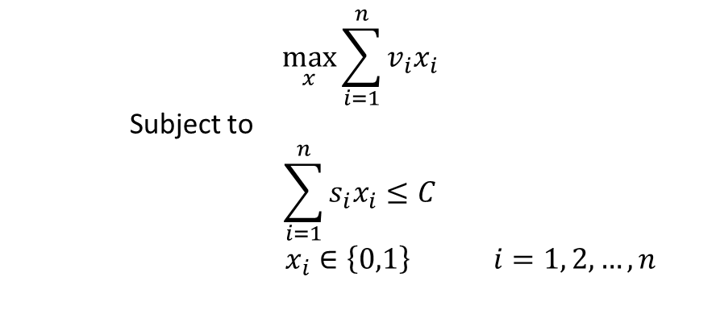
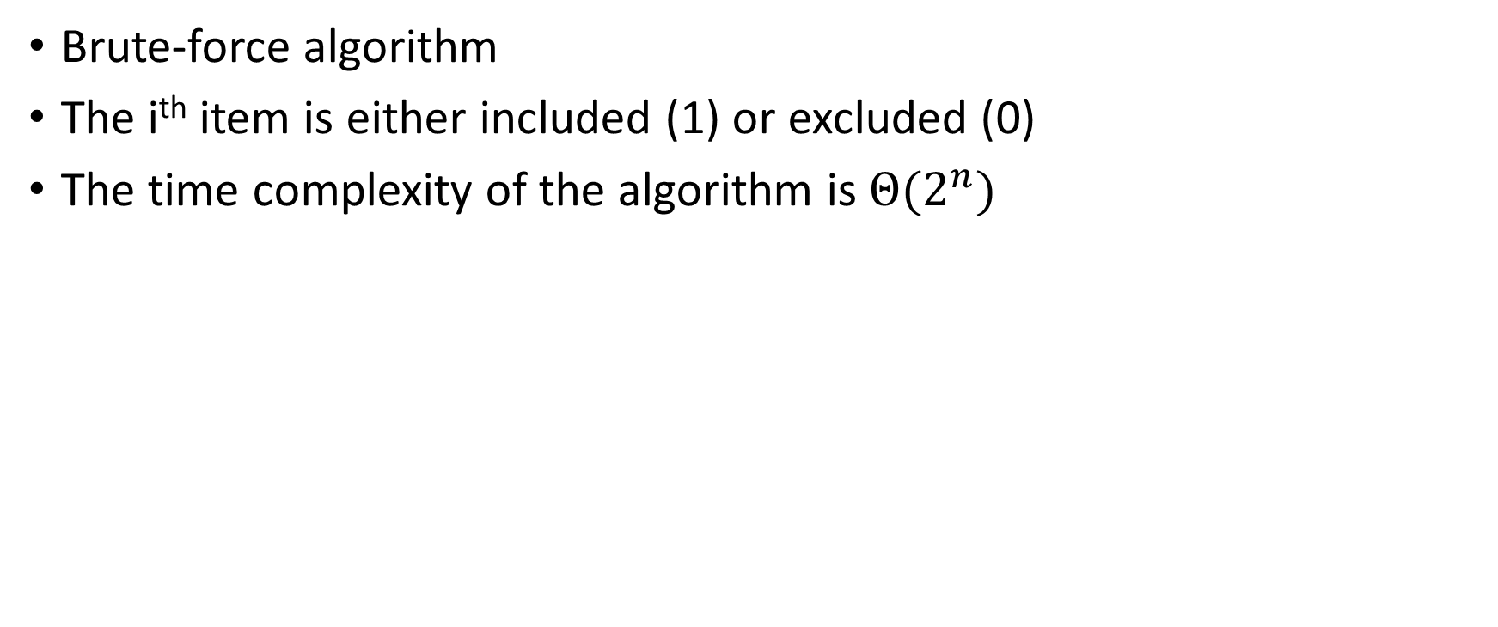
0/1 Knapsack
$$\max_{x}{\sum_{i=1}^{n}{v_{i}x_{i}}}$$
Subject to
$$\sum_{i=1}^{n}{s_{i}x_{i}}≤C$$
$x_{i}∈\left\{0,1\right\}$ $i=1, 2, …,n$
Brute-force algorithm
The i^{th} item is either included (1) or excluded (0)
The time complexity of the algorithm is $Θ(2^{n})$
Item 1 | Item 2 | Item 3 | Value
0 | 0 | 0 | 0
0 | 0 | 1 | V3
0 | 1 | 0 | V2
0 | 1 | 1 | V2+V3
1 | 0 | 0 | V1
1 | 0 | 1 | V1+V3
1 | 1 | 0 | V1+V2
1 | 1 | 1 | V1+V2+V3
Can you see that some sub-problems are overlapping?

Slide 86
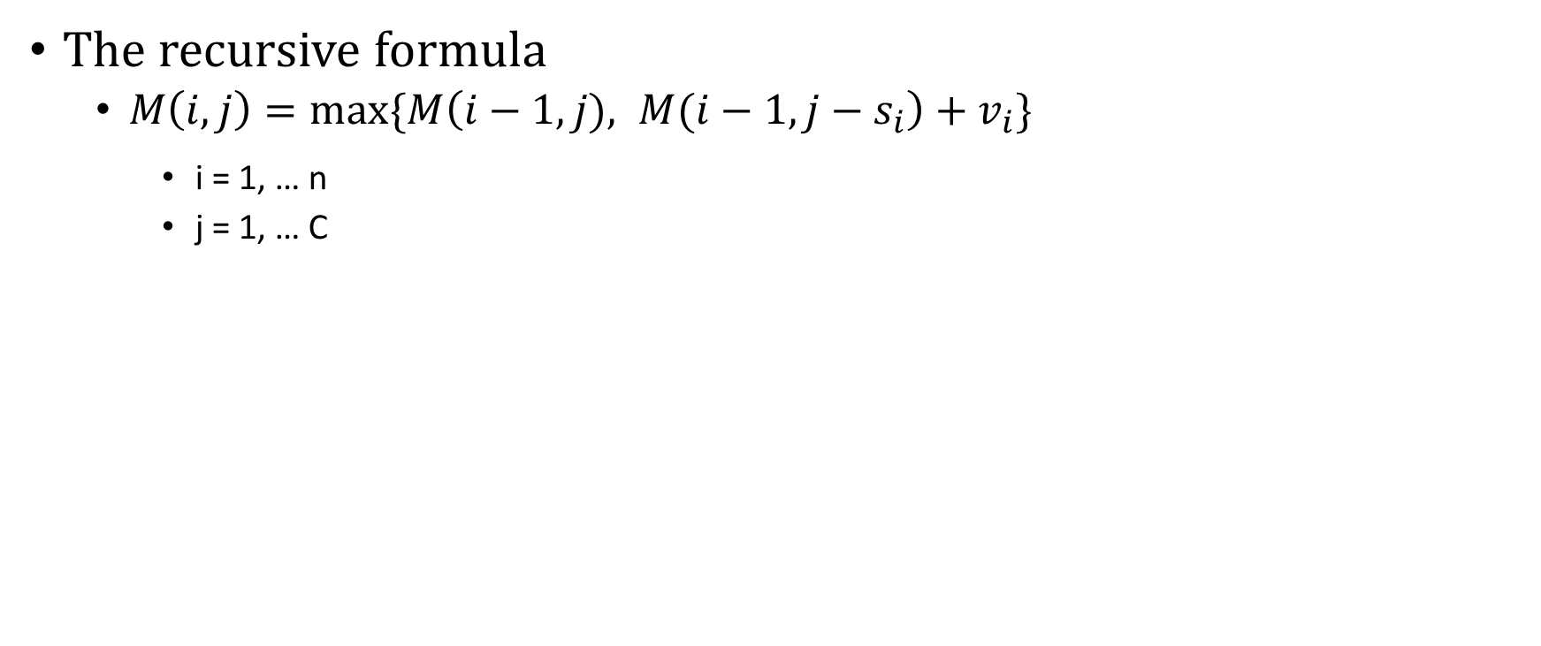
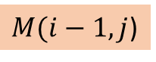
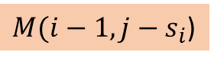
Using DP to solve 0/1 Knapsack
j
 | 1 | 2 | 3 | … | C
1
2
…
n
$M(i−1,j$)
0 v₁ v₁ v₁ v₁
$M(i−1,j−s_{i}$)
i
v₂ v₁ v₁ + v₂ v₁ + v₂ v₁ + v₂
M(i,j)
The recursive formula
$M\left(i,j\right)=\max_{}{\{M\left(i−1,j), M(i−1,j−s_{i}\right)+v_{i}\}}$
i = 1, … n
j = 1, … C
ith item is unused
ith item is used
The capacity of knapsack is 5kg. (C = 5)
Capacity
Item | Weight | Value
1 | 2kg | $12
2 | 1kg | $10
3 | 3kg | $20
4 | 2kg | $15
i \ j | 1 | 2 | 3 | 4 | 5
1
2
3
4
$0
$12
$12
$12
$12
Item
$10
$12
$22
$22
$22
$10
$12
$22
$30
$32
$10
$15
$25
$30
$37
Notes:
0 because item 1 is 2kg which exceeds the capacity 1

Slide 87
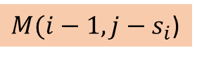
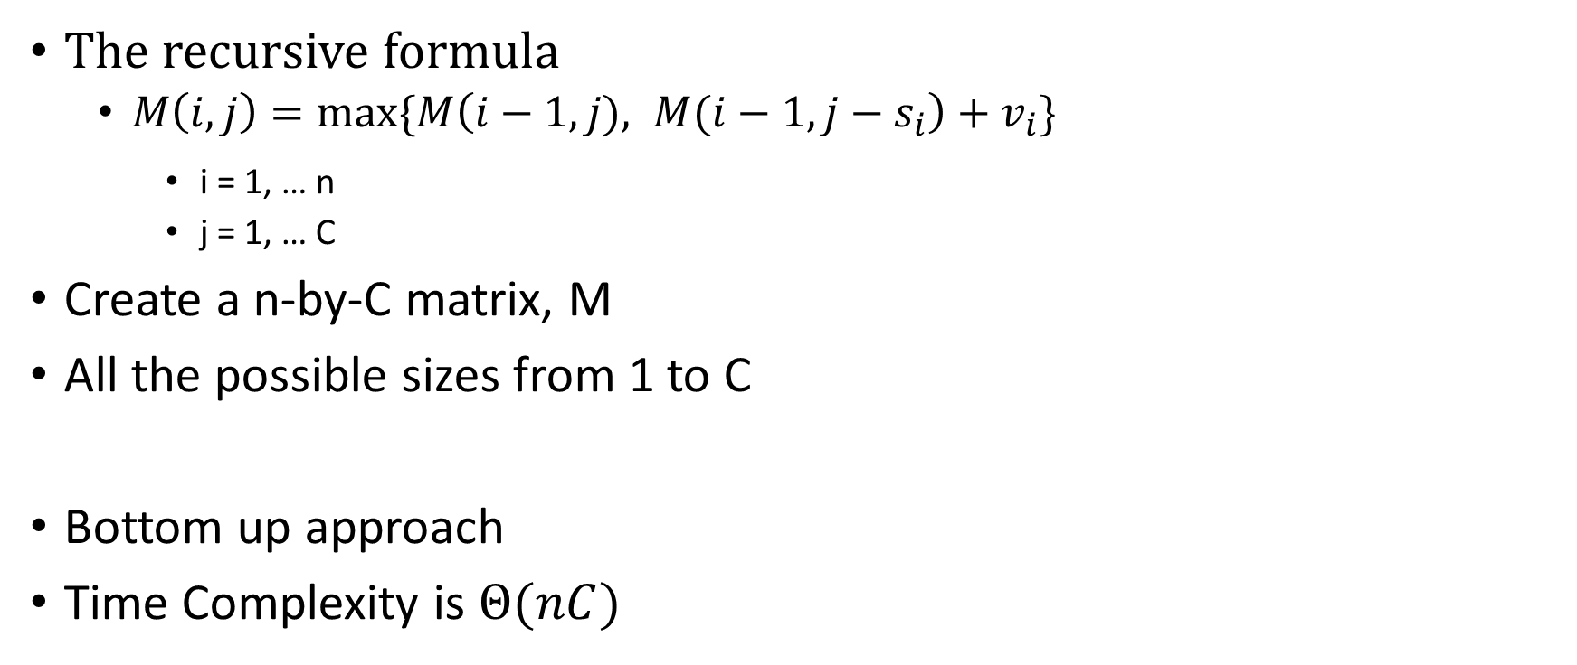
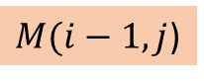
Using DP to solve 0/1 Knapsack
The recursive formula
$M\left(i,j\right)=\max_{}{\{M\left(i−1,j), M(i−1,j−s_{i}\right)+v_{i}\}}$
i = 1, … n
j = 1, … C
Create a n-by-C matrix, M
All the possible sizes from 1 to C
Bottom up approach
Time Complexity is $Θ(nC)$
ith item is unused
ith item is used
j
 | 1 | 2 | 3 | … | C
1
2
…
n
0 0 v₁ v₁ v₁
$M(i−1,j−s_{i}$)
$M(i−1,j$)
i
0 v₂ v₁ v₁ + v₂ v₁ + v₂
M(i,j)
0

Slide 88
Summary
Dynamic Programming
Rod Cutting Problem
0/1 Knapsack Problem

